Slide 1







Slide 2

Members
Zavarynskiy Nazar
Kromkach Vladyslav
Blyzniuk Andrian
Chycherskiy Vitaliy
Stefanyshyn Nazar
Klochnyk Yaroslav
Mentor

Slide 3
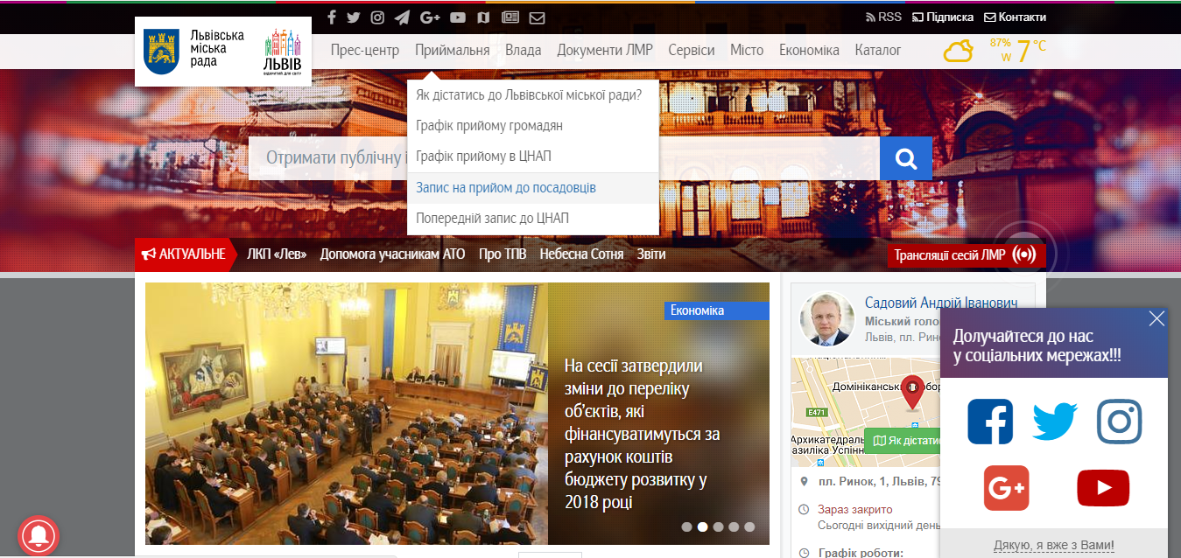
IDEA
The main idea was to have an ability to use mobile device for subscribing to a CNAP or to a particular official person.

Slide 4



Advantages
Opponents:
View the queue state
Users can subscribe to a CNAP
…to an audience with official person.
Add an overview
Online support
Register of services
Web version in the app
- Long load time
+ The same functionality - Design

Slide 5





FRONT-END
BACK-END
Mobile User App
Server
Request
HTTP(S)Protocol
Response
Request
Request
Response
Response
HTTP(S)Protocol, JSON Data
Admin Web
Database

Slide 6




MOBILE
What we used?
Java Android
Retftofit2
Aes + cipher encryptor/decryptor

Slide 7




WEB
What we used?
HTML/CSS
JS
Jquery/Jquery UI
Bootstrap

Slide 8





BACK-END
What we used?
Python
Django
Django rest framework
Python anywhere
Cipher + aes encryptor/decryptor
Cors-headers
Django-filters
Database : MySQL

Slide 9



Communication
What we used?
Version control : GitHub
Task controller: Trello
Team messenger: Slack

Slide 10
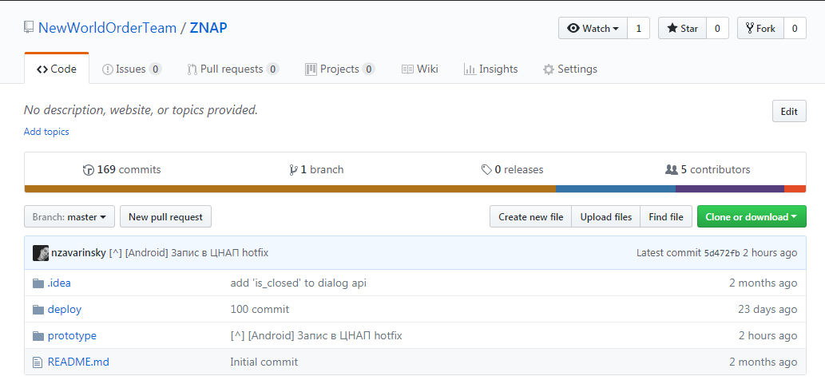
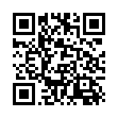
OUR GITHUB REPO

Slide 11
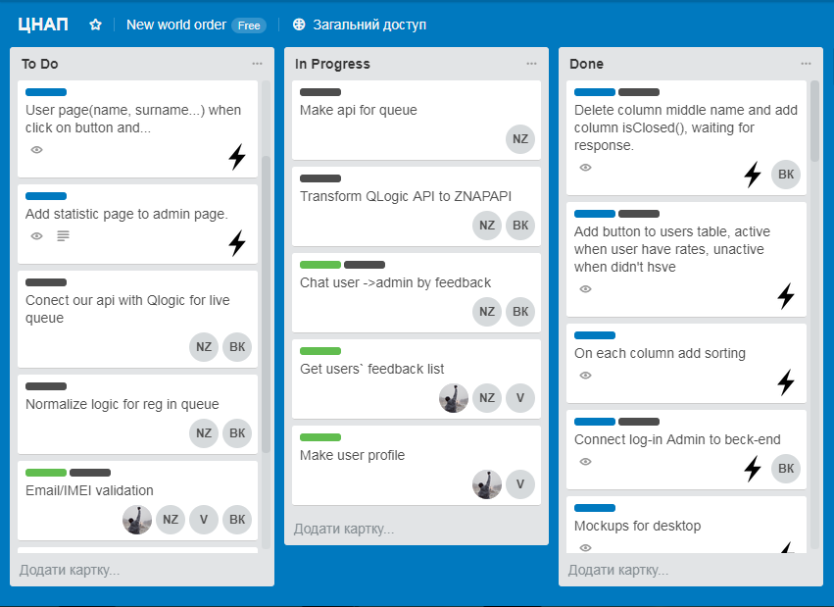
OUR TRELLO

Slide 12
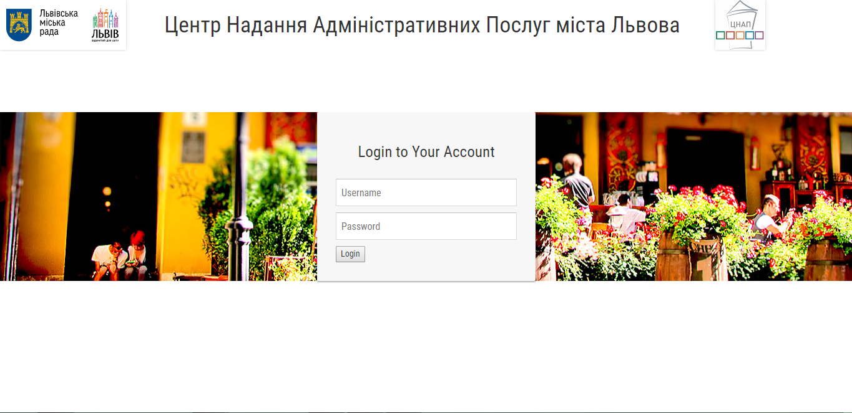

Slide 13
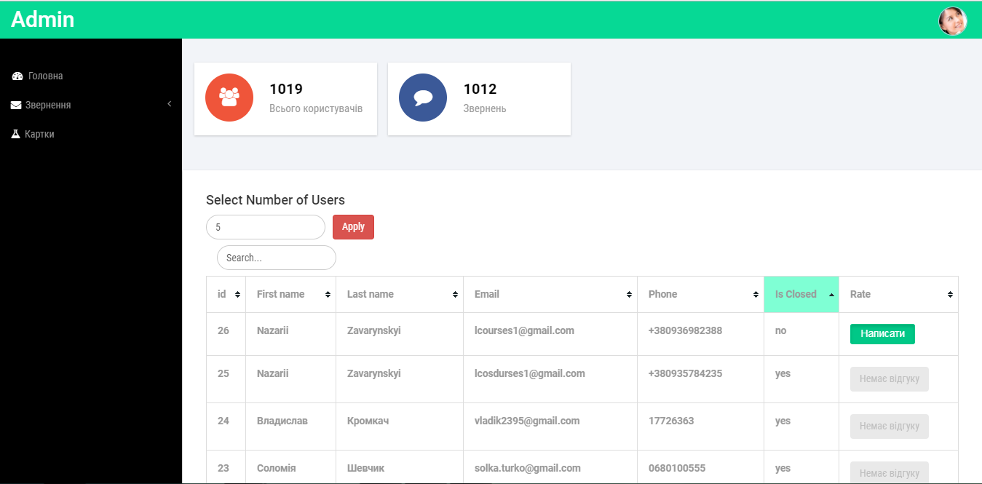

Slide 14

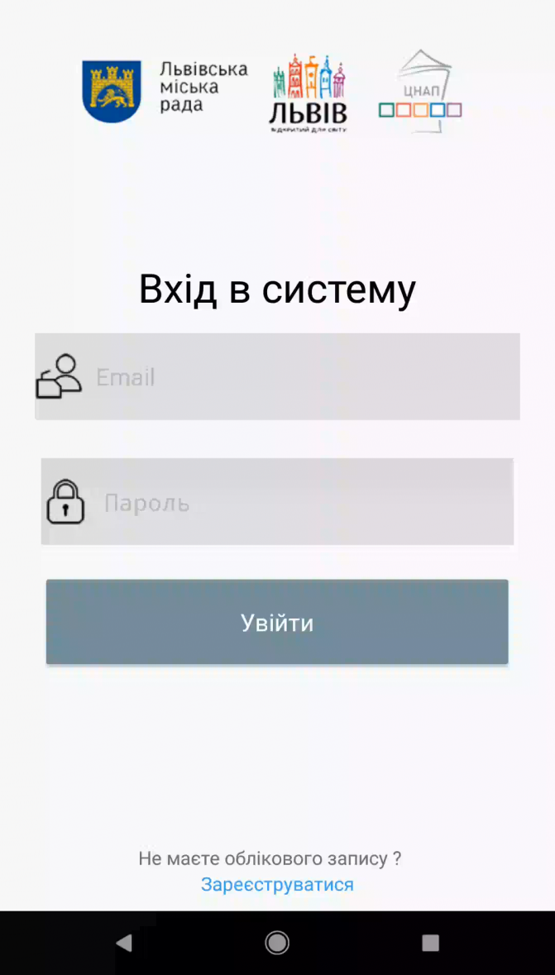
DEMO

Slide 15


FUTURE PLANS
Next steps:
Integration with Qlogic
Finishing Admin`s page
Security (Finishing AES Cipher encryption/decription, Emei validation)
Publishing on Play Market (approximately May, 2018)

Slide 16

Any Questions

